Slide 1
Interactive digital Portfolio
CAPSTONE PROJECT
Presented By:
Chakka Satyasree-Malla Reddy College of Engineering for Women-CSE
AICTE ID : STU65b273ddd1b2f1706193885

Slide 2
OUTLINE
Problem Statement
System Development Approach (Technology Used)
Algorithm & Deployment (Step by Step Procedure)
Result
Conclusion
Future Scope
References

Slide 3
Problem Statement
Lack of Interactivity in Traditional Resumes – Conventional resumes are static and fail to showcase creativity, problem-solving ability, and technical skills interactively.
Limited Visual Appeal – Recruiters often find resumes monotonous, making it harder for developers to stand out in a competitive job market.
Ineffective Skill Representation – Listing skills in plain text does not fully reflect proficiency levels or practical applications through projects.
Poor Accessibility of Projects – Sharing project details via documents or GitHub links lacks context and visual presentation, reducing impact.
Difficulty in Creating a Personal Brand – Without a personalized digital presence, developers struggle to differentiate themselves and establish credibility.
Low Engagement from Recruiters/Clients – Static portfolios don’t capture attention as effectively as interactive and animated web experiences.
Fragmented Presentation of Information – Skills, projects, and contact details are often scattered across multiple platforms (resumes, LinkedIn, GitHub), making it inconvenient for viewers.

Slide 4
System Approach
1. Problem Identification
Developers struggle to showcase their skills and projects effectively.
Traditional resumes lack interactivity and engagement.
2. System Objectives
Create an interactive, user-friendly portfolio website.
Showcase skills, projects, and contact details in one platform.
3. System Requirements
Frontend: HTML, CSS, JavaScript.
Features: Smooth scrolling, animations, responsive design, dark/light mode.
Content Sections: About Me, Skills, Projects, Contact.
Deployment: Can be hosted on GitHub Pages, Netlify, or personal server.

Slide 5
System Approach
1. 4. System Design
Architecture: Single Page Application (SPA) style with navigation.
UI/UX Design:
Hero section with typing animation.
Cards for skills and projects with hover effects.
Smooth reveal animations on scroll.
Contact cards for email, LinkedIn, and GitHub.
Theme Toggle: Light/Dark mode using CSS variables.
5. System Implementation
HTML: Structure of sections (About, Skills, Projects, Contact).
CSS: Styling, animations, transitions, responsiveness.
JavaScript: Navigation, smooth scrolling, reveal effects, theme toggle.
6. System Testing
Responsiveness testing on multiple devices.
Cross-browser compatibility check.
Performance optimization (loading speed, smooth animations).
7. System Output
A fully functional, visually appealing, and interactive portfolio website.
Engaging user experience with animations and navigation.
Single point of access for recruiter to know about developer’s profile.

Slide 6
Algorithm & Deployment
Step 1: Start. Step 2: Load the portfolio website in the browser. Step 3: Display Hero section with typing animation. Step 4: Wait for user interaction (scroll / click navigation). Step 5: If navigation link is clicked → Scroll smoothly to target section. Step 6: When section comes into view → Trigger reveal animation (skills, projects, contact cards). Step 7: If user clicks theme toggle → Switch between Light/Dark mode. Step 8: If user selects contact option → Redirect to email, LinkedIn, or GitHub. Step 9: Continue until user exits the website. Step 10: End.

Slide 7
Algorithm & Deployment
Deployment Steps
Prepare Project – Organize index.html, style.css, script.js and test locally.
Use GitHub – Push code to a GitHub repository.
Choose Hosting –
GitHub Pages → Enable Pages in repo settings.
Netlify → Drag & drop folder / connect repo.
Vercel → Import repo & deploy.
Verify – Test link on different devices & browsers.
Maintain – Update repo → site auto-updates.

Slide 8
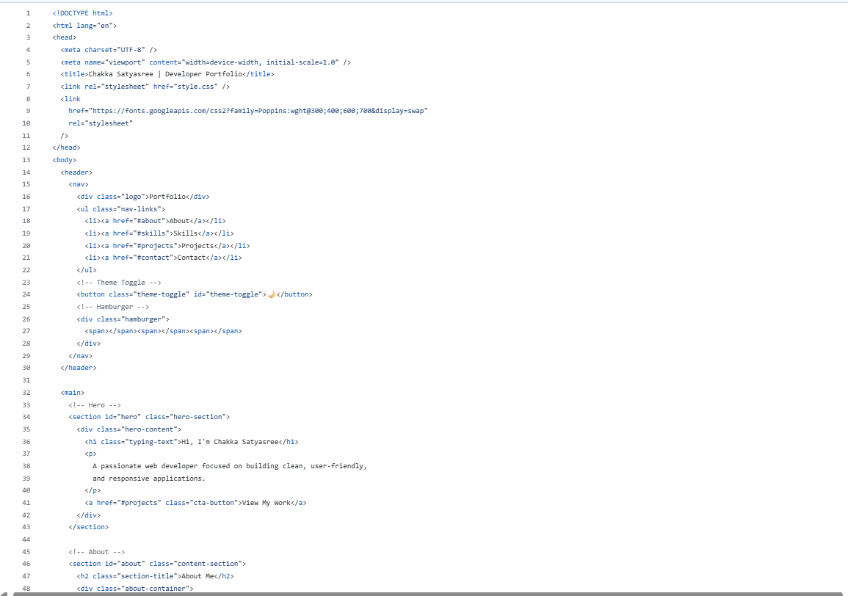
Result

Slide 9
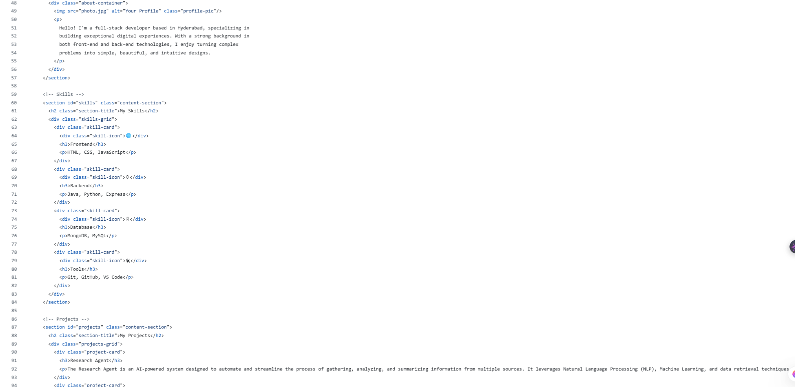
Result

Slide 10
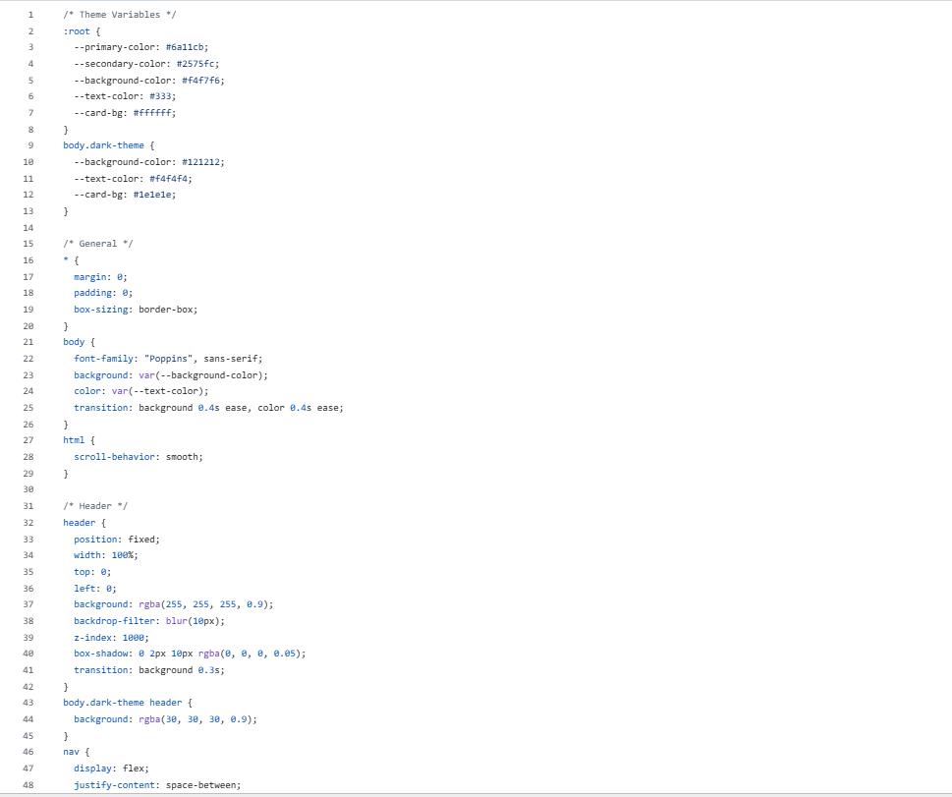
Result

Slide 11
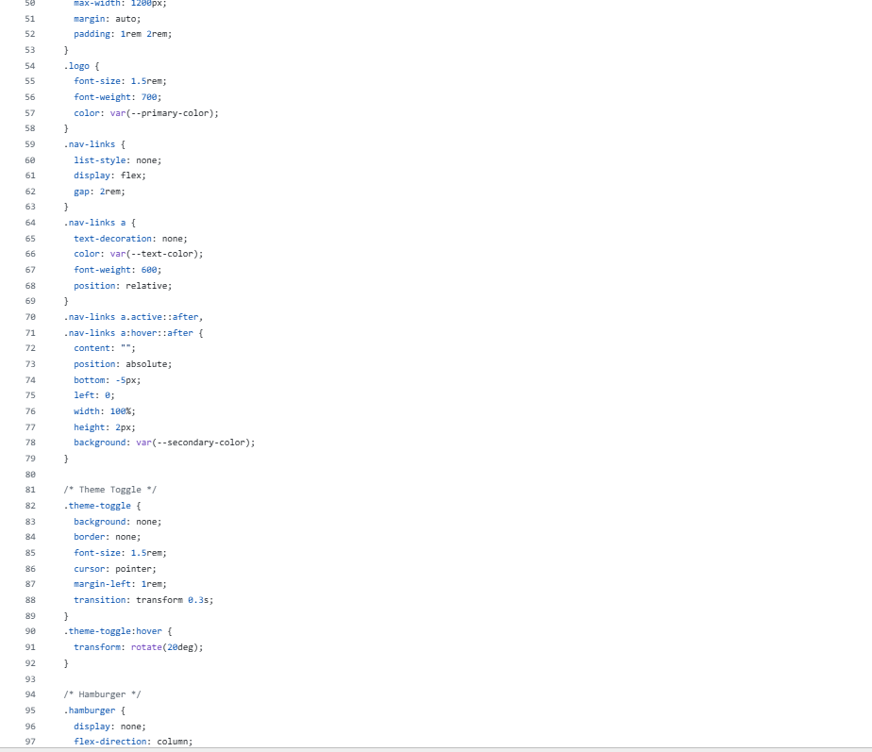
Result

Slide 12
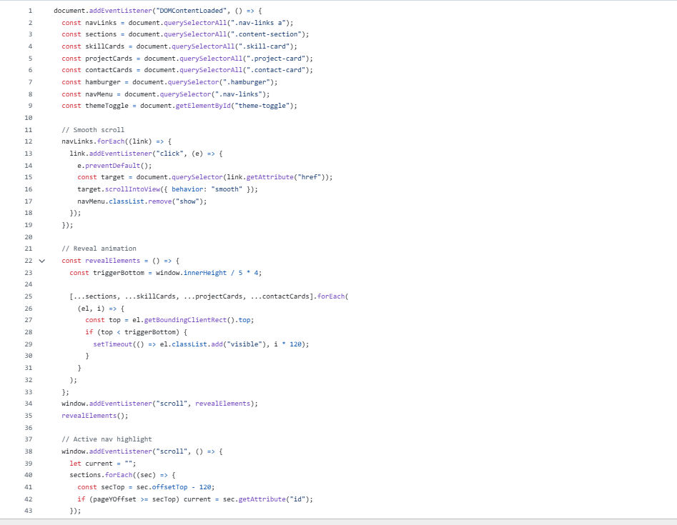
Result

Slide 13
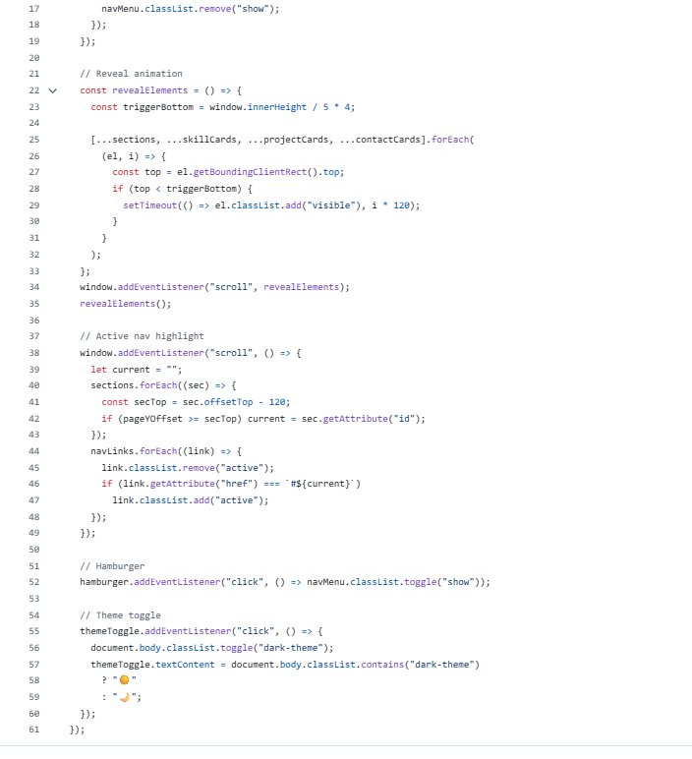
Result

Slide 14
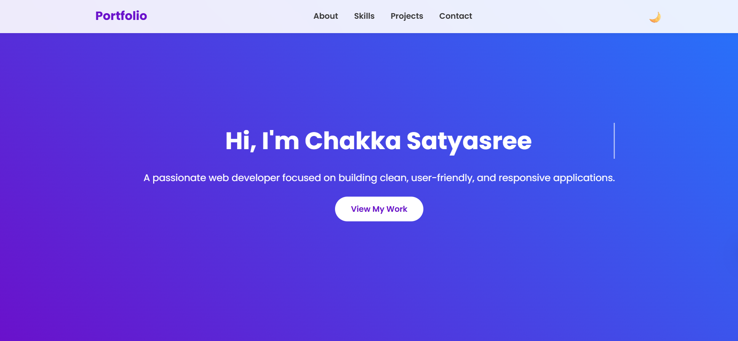
Result

Slide 15
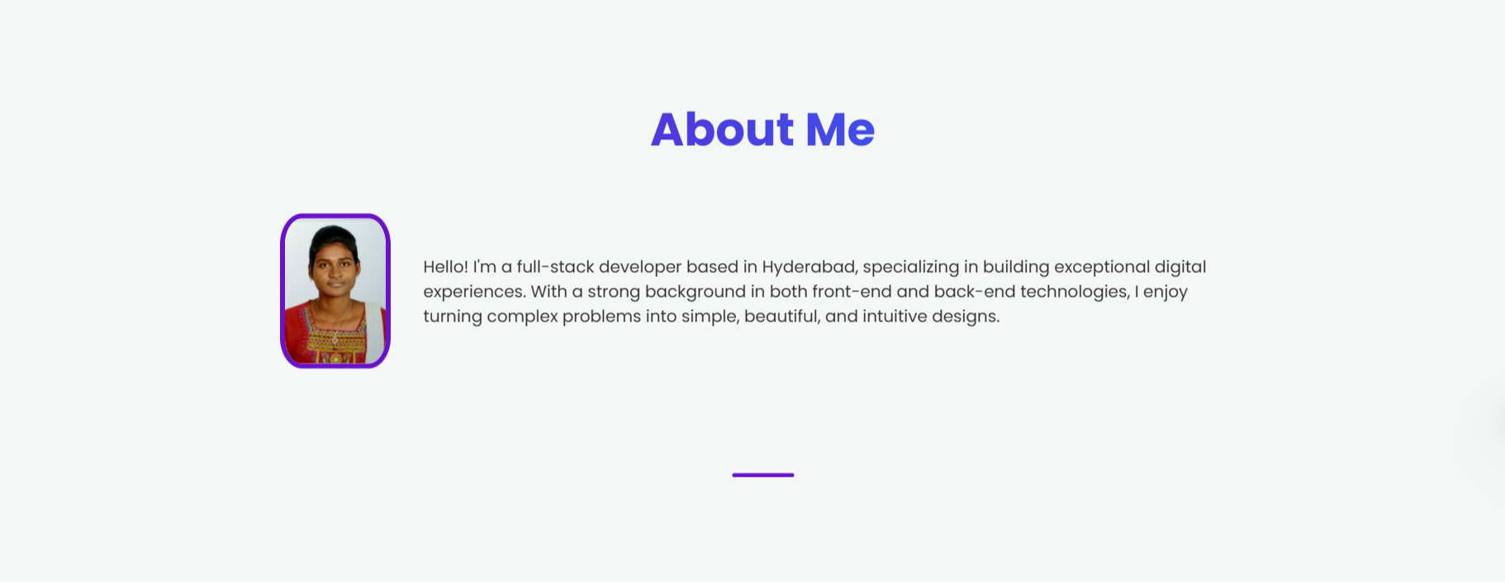
Result

Slide 16
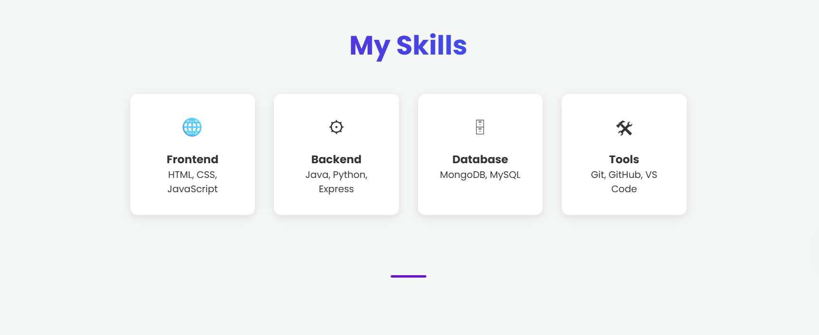
Result

Slide 17
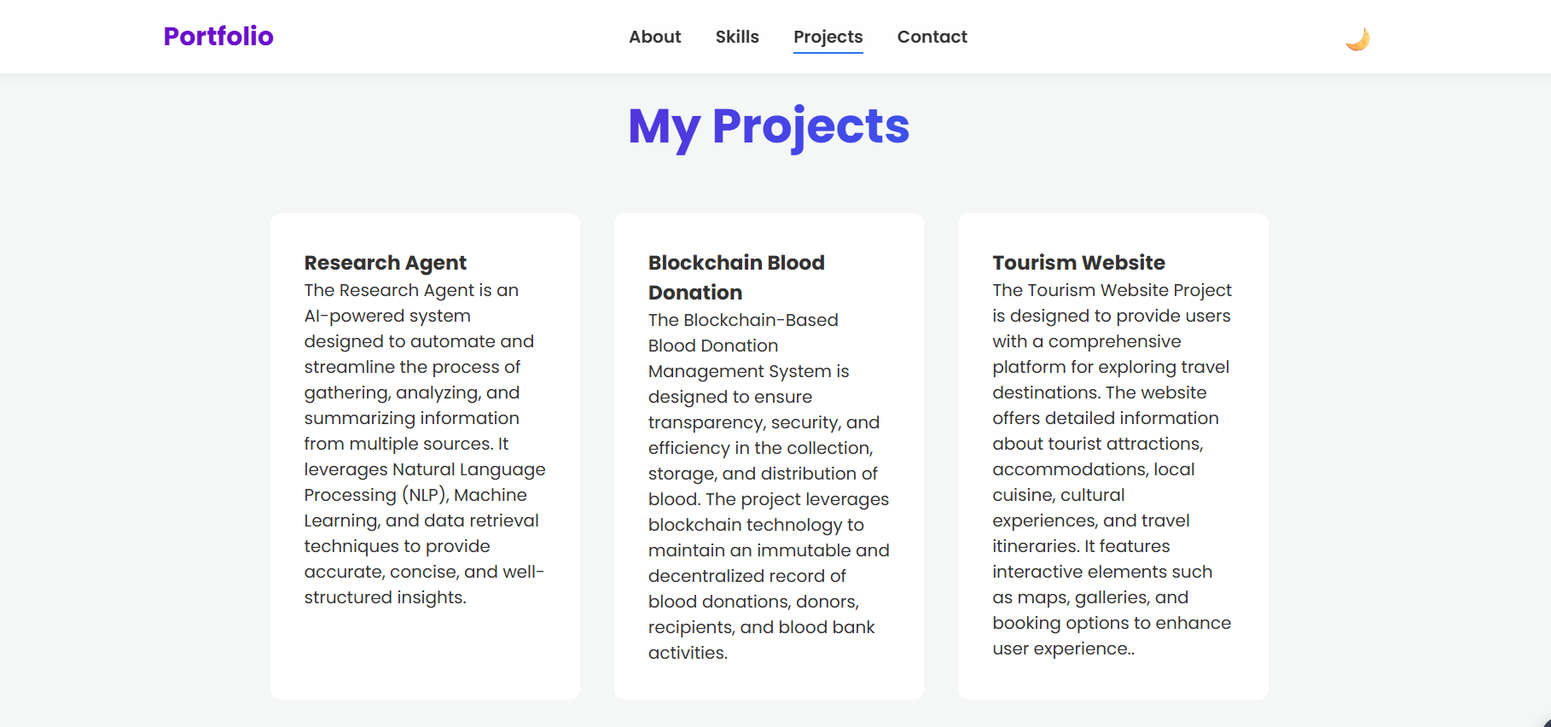
Result

Slide 18
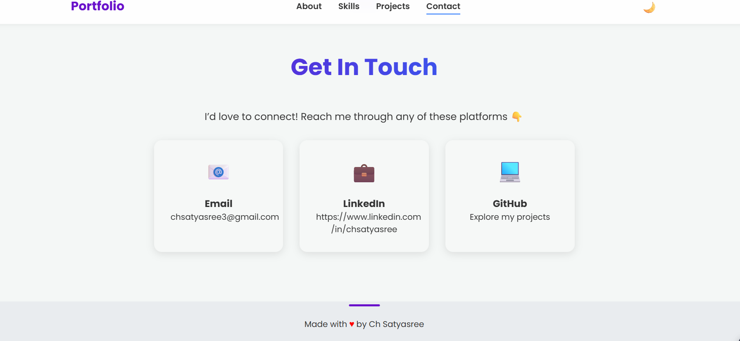
Result

Slide 19
GitHub Link : https://github.com/Chsatyasree3/portfolio.git
Deployment Link : https://chsatyasree3.github.io/portfolio/

Slide 20
Conclusion
Developed a dynamic, interactive portfolio website.
Overcomes limitations of static resumes.
Showcases skills, projects, and contact details in one place.
Features smooth navigation, animations, and theme toggle.
Provides a responsive and user-friendly design.
Enhances personal branding and recruiter engagement.
Easily deployable on GitHub Pages, Netlify, or Vercel.
Acts as a modern digital resume for career opportunities.

Slide 21
Future scope
Add live project demos and hosted links.
Integrate a contact form with email service/API.
Include a section for blogs, certifications, or achievements.
Use React, Angular, or Vue for more scalability and performance.
Add backend integration (Node.js, Firebase) for dynamic content.
Implement analytics to track recruiter visits and engagement.
Provide multi-language support for global accessibility.
Enhance with AI-powered chat assistant for guided portfolio tours.

Slide 22
References
Blyth, D. L., Jarrahi, M. H., Lutz, C., & Newlands, G. (2024) – Self‐branding strategies of online freelancers on Upwork – Shows how portfolios enhance personal branding and client engagement.
Calderón‐Garrido, D., Gil‐Fernández, R., & Martín‐Piñol, C. (2023) – Educational Digital Portfolio in the Arts – Discusses flexibility, multimodal content, and identity building through portfolios.
CSS Tricks – Design and animation techniques 🔗 https://css-tricks.com
FreeCodeCamp – Responsive web design and portfolio building guides 🔗 https://www.freecodecamp.org
GitHub Pages Documentation – Free hosting for static websites 🔗 https://docs.github.com/en/pages
Netlify Documentation – Deploying static sites easily 🔗 https://docs.netlify.com
Vercel Documentation – Frontend deployment and hosting 🔗 https://vercel.com/docs

Slide 23
THANK YOU

